Slide 1
HOW DO ORGANISMS REPRODUCE
TYPES OF ASEXUAL REPRODUCTION

Slide 2
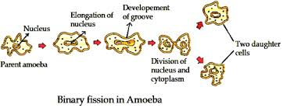
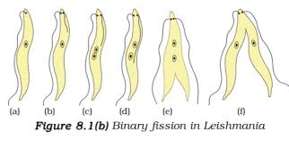
BINARY FISSION
AMOEBA
LEISHMANIA

Slide 3
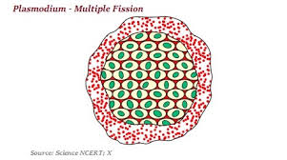
MULTIPLE FISSION
PLASMODIUM

Slide 4
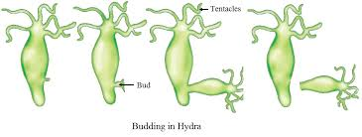
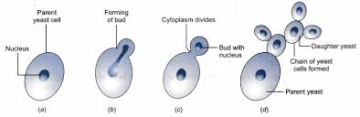
BUDDING
YEAST
HYDRA

Slide 5
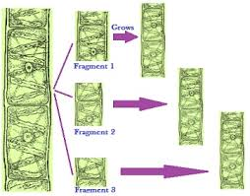
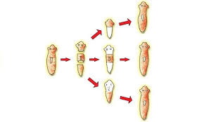
FRAGMENTATION
SPIROGYRA
PLANARIA

Slide 6
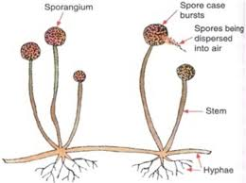
SPORE FORMATION
RHIZOPUS

Slide 7
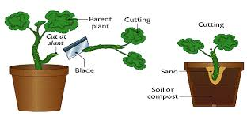
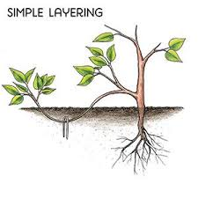
VEGETATIVE PROPAGATION
CUTTING (STEM)
LAYERING (STEM)

Slide 8
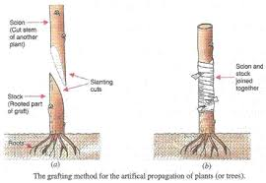
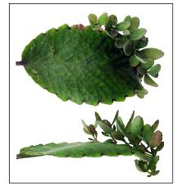
VEGETATIVE PROPAGATION
GRAFTING (STEM)
BRYOPHYLLUM (LEAF)

